Slide 1

JavaScript Applications
Course Overview
SoftUni Team
Technical Trainers
Software University
https://softuni.bg

Slide 2
Table of Contents
Introduction
Training & Team
Course Objectives
Course Organization

Slide 3
Have a Question?
sli.do
#js-advanced

Slide 4












SoftUni Diamond Partners

Slide 5




SoftUni Organizational Partners

Slide 6
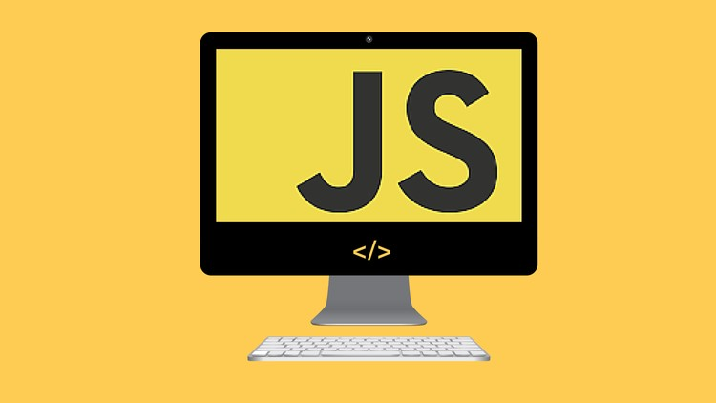
JS Applications
Course Objectives & Program

Slide 7

What Are We Going to Learn?
Unit Testing and Modules
REST Services and AJAX - HTTP, REST and RESTful Services, AJAX and Fetch API
Asynchronous Programming - Promises, Async/Await
Remote Databases - Firebase
Templating - Templating Concepts, Template Engines, Handlebars Overview

Slide 8
What Are We Going to Learn? (2)
Routing - Routing Concepts and Navigation using Sammy.js
Workshop – Single Page Application (SPA)
Design Patterns and Best Practices – Factory, Decorator, Façade pattern
Workshop – Custom Component
Project Architecture – Packages, Dependencies, Webpack

Slide 9

Trainers and Team

Slide 10

Ilia Idakiev
Software developer-entrepreneur
Co-Founder @ HILLGRAND
Google Developer Expert
Co-organizer of Angular Sofia and SofiaJS / BeerJS
Lecturer at Sofia University (FMI)
"Advanced JavaScript" course

Slide 11
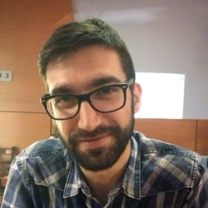
Viktor Kostadinov
Has been Technical trainer for 3 years in the software industry
Former director of the Education Department
Currently the head of the R&D Unit at Software University

Slide 12

Course Details and Schedule

Slide 13
Targets of the Course
The JavaScript Applications course provides
Technologies for creating Single Page Apps (SPA)
Consuming RESTful Services (REST) with AJAX
Creating UI templates
Common JS programming patterns and routing

Slide 14

Practical Exam – 8 Aug 2020
SPA (Single Page Application) for 4 hours
Implement CRUD operations
Authentication
login / register / logout
https://judge.softuni.bg/Contests/Practice/Index/1656#0

Slide 15
Theoretical Exam – 08 Aug 2020
20 questions for 30 minutes
Multiple-choice with 1 correct answer
English
Automated quiz system
Available online
You can submit your answers just one time

Slide 16


Scoring System for the Course
Theoretical Exam 5%
PracticalExam 90%
Evaluation
Homework 5 %

Slide 17

Evaluation Criteria
Mandatory
Final exam - 90%
Theoretical exam - 5%
Exercises/Homework - 5%

Slide 18
Questions?
Notes:
18

Slide 19
Trainings @ Software University (SoftUni)
Software University – High-Quality Education, Profession and Job for Software Developers
softuni.bg, about.softuni.bg
Software University Foundation
softuni.foundation
Software University @ Facebook
facebook.com/SoftwareUniversity
Software University Forums
forum.softuni.bg
Notes:
19

Slide 20

License
This course (slides, examples, demos, exercises, homework, documents, videos and other assets) is copyrighted content
Unauthorized copy, reproduction or use is illegal
© SoftUni – https://about.softuni.bg/
© Software University – https://softuni.bg
Notes:
20

